Slide 1
Academy Lab Projects – Showcase
<Phạm Văn Phúc>
<Cloud Security Builder>
Notes:
For Educators: You can use this template to help your students effectively present and communicate their project to a broader audience. Your students can also use this presentation as a portfolio of their work to demonstrate their cloud skills.
The presentation structure is listed below. The total time may vary depending on the activity you want to conduct. For example, you may want your students to provide high-level walkthrough of their final solutions versus deep-dive into why or how they chose certain services and the steps of building their architectures.
Suggested timing for a 15-minute presentation:
Introduction – 30 seconds
Business scenario overview – 1 minute
Solution overview – 5 minutes
Architecture diagram of the solution – 2 minutes
Demo – 5 minutes
Lessons learned – 1.5 minutes

Slide 2
Business scenario overview
Doanh nghiệp sử dụng AWS thường cấu hình sai dịch vụ dẫn đến rò rỉ dữ liệu:
S3 bucket bị public ngoài ý muốn
Security Group mở cổng SSH toàn thế giới
Tài khoản IAM không bật xác thực MFA
->Cần một công cụ nhẹ, chạy được local để rà soát bảo mật cơ bản trước khi triển khai.
Dễ dùng, hiển thị kết quả trực quan
Viết bằng Python (boto3) + Flask
Notes:
Define the problem or opportunity that you are addressing. Include pictures, figures, and statistics to help the audience better conceptualize the problem or opportunity.
Specify who your users or customers are and what pain points they are experiencing.
For example: “Users complain that the student admissions department website is too slow and isn’t always available.”
Also, list any specific business requirements that you are addressing.
For example: “Improve the experience for users. The web application can be deployed to the AWS Cloud. The application must be highly available, scalable, load balanced, secure, and performant architecture that can support thousands of users.“
Note:
An above-bar overview succinctly defines the problem and opportunity statement. For example: “Customers with media files, such as retail companies, need an easy and cost-effective way to analyze photos and videos of their inventory.”
A below-bar overview is too verbose, technical, or not specific. For example: “The most common media files are .jpg and .mp4. Companies have media files of their inventory.”

Slide 3
Solution overview
Mô tả tổng quát
Ứng dụng viết bằng Python.
Kết nối AWS API qua LocalStack.
Web UI Flask để hiển thị báo cáo.
Các module kiểm tra:
S3: phát hiện bucket public
EC2: phát hiện security group mở cổng 22/3389
IAM: phát hiện user chưa bật MFA
Use Cases
Kiểm tra nhanh cấu hình AWS trong môi trường dev/test
Demo bảo mật cloud đơn giản cho sinh viên
Bước đầu xây dựng CI/CD security checker
Notes:
Explain at a high level what you have built.
For example: “I built a web application for a company to host their blog.“
Talk about why you chose certain parts of the solutions and any tradeoffs that you made. Focus on how you designed the solutions and how you applied the AWS Well-Architected Framework as part of the process (AWS Well-Architected Framework: https://docs.aws.amazon.com/wellarchitected/latest/framework/welcome.html).
For example: “I configured load balancers and auto scaling to make the application highly available and reliable.”
Include the use cases that you are addressing. Think about who your users are and how they would want to interact with your solution to solve their problem.
For example: “Users can view, upload, edit, and delete blog posts. Administrators can approve blog posts.”
Talk about the use cases that you addressed as part of the minimum viable product (MVP) that you scoped and built.
Note:
An above-bar description is concise and includes the most important benefits. For example: “The solution allows customers to quickly upload, store, and search large catalogs of images and videos in Amazon S3.”
A below-bar description is too detailed or not specific. For example: “Our solution analyzes media files.”

Slide 4
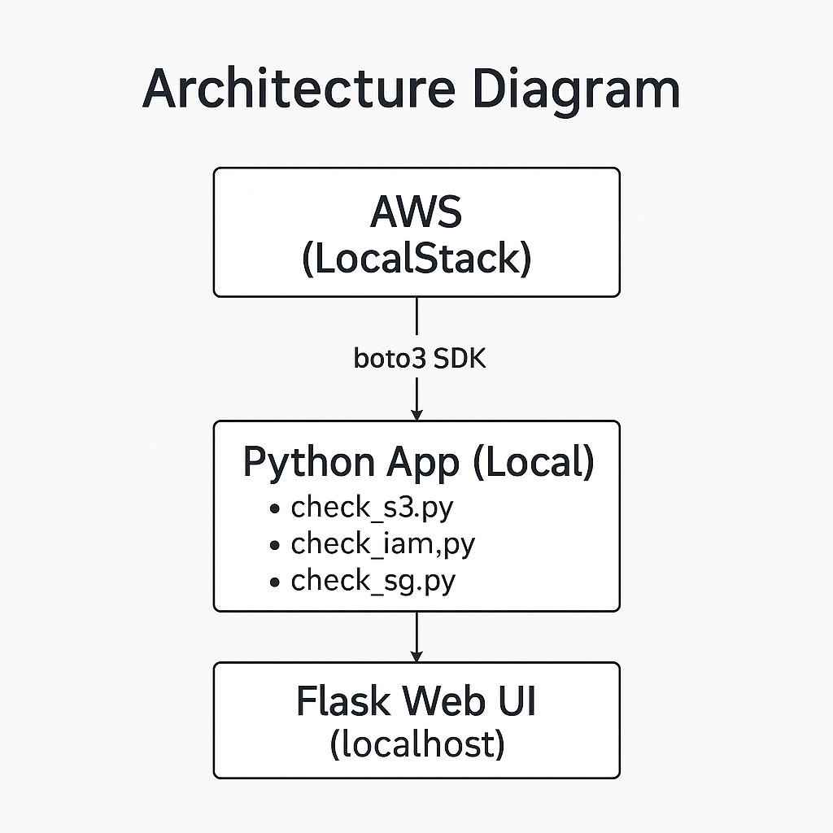
Architecture diagram of the solution
Notes:
Use the following resources to create a diagram of your application architecture:
AWS Architecture Icons at https://aws.amazon.com/architecture/icons. This page includes diagram assets as well as links to drawing and diagramming tools that you can use.
As you walk through the architecture, make sure that you relate back to the business requirements and the AWS Well-Architected Framework (https://docs.aws.amazon.com/wellarchitected/latest/framework/welcome.html).
You can also go more in depth about the design considerations and trade-offs that you made.

Slide 5
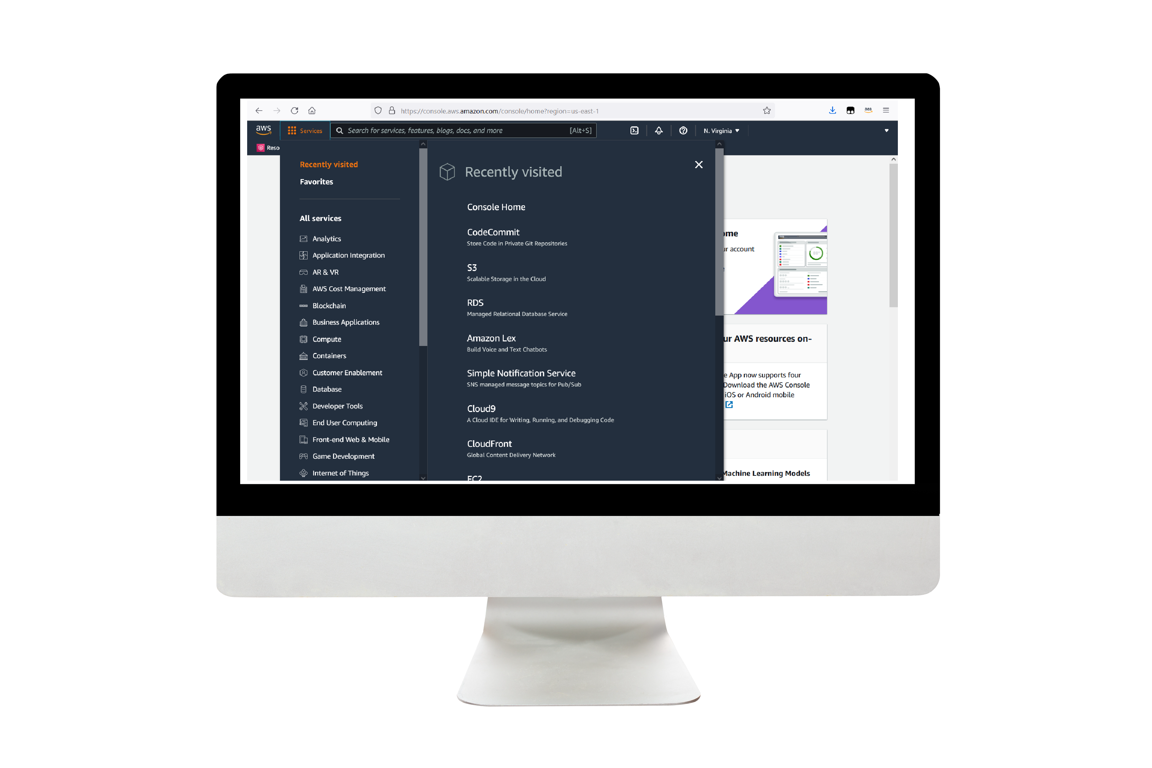
Demo
Include the link to the demo materials.
Notes:
For the demo, guide the audience through the two to three most important benefits of the solution and how it addresses the requirements.
Your demo materials can be screen captures, recordings, a link to your final solution, and/or a link to AWS console.

Slide 6
Lessons learned
Thử thách vượt qua:
Làm quen SDK boto3 & API của AWS
Thiết lập LocalStack và sửa code để kết nối đúng endpoint giả lập
Truy vấn và phân tích cấu trúc dữ liệu trả về từ các dịch vụ AWS
🛠️ Kỹ năng học được:
Giao tiếp với AWS API qua Python
Tổ chức project theo mô-đun kiểm tra
Xây dựng web UI đơn giản với Flask
Tài nguyên hữu ích:
Boto3 Docs
LocalStack Docs
ChatGPT hỗ trợ phát triển, chỉnh lỗi và viết báo cáo
Notes:
Describe any challenges that you encountered and how you overcame those challenges.
For example: “I got stuck when I was creating an EC2 instance to host the application. I used the resources that were listed in the instructions to walk myself through the process to create a new EC2, and I was able to complete the task. The links to labs in other courses were very helpful.”
Describe any new skills that you learned from this project.
For example: “I learned how to set up auto scaling correctly so my resources were automatically adjusted and allocated at the lowest possible cost.”
Discuss any future, out-of-scope use cases in the next steps.
For example: “I would like to scale out the web application so that multiple departments can use it.”

Slide 7
Thank you

